Slide 1
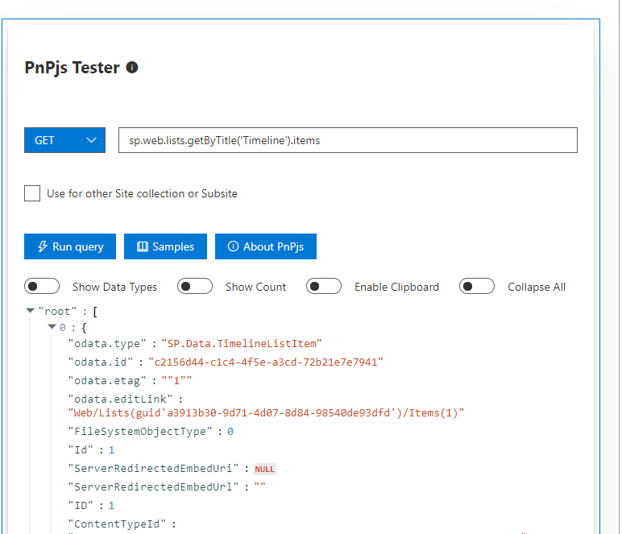

SPFx webpart to Test PnPjs SharePoint Methods
react-pnpjsexplorer
Siddharth Vaghasia (@siddh_me)
Kunj Sangani(@sanganikunj)

Slide 2









Siddharth Vaghasia
Technical Consultant - SharePoint, Office 365, Azure, .NET, NODE JS
Speaker | Blogger | PnP contributor | SharePoint stack overflow contributor
C# Corner MVP | MCP | MCTS
https://siddharthvaghasia.com
https://c-sharpcorner.com/members/siddharth-vaghasia
@siddh_me
siddharth-vaghasia
https://www.linkedin.com/in/siddharthvaghasia
siddh.vaghasia@gmail.com
siddharth.vaghasia

Slide 3

react-pnpjsexplorer
SPFx webpart to Test PnPjs SharePoint Methods
https://github.com/pnp/sp-dev-fx-webparts/tree/master/samples/react-pnpjsexplorer

Slide 4
Driving factor
Most of the SharePoint developers are using PnP JS to develop SPFx solutions.
During the development, there are times when we wanted to know what properties/attributes will be returned in response
To get these details, we either use console.log to log response or debug the JavaScript and check what properties/attributes are returned etc
This web part can be used so that we can quickly test any SharePoint REST API methods using PnP JS.

Slide 5
Summary
Utility Web Part for Developers
Test PnP JS SharePoint package methods
Response will be displayed in a code format.
By default, it will run in context of current site collection
Optional option to enter different site collection or sub site url to set PnP JS context to different url (other than current context)
Support for Get and Post methods.
Option to see some examples which can be copied and tested just by changing list/libraries/column names.

Slide 6
Demo/ Code Walkthrough

Slide 7
THANK YOU
https://siddharthvaghasia.com
https://c-sharpcorner.com/members/siddharth-vaghasia
@siddh_me
siddharth-vaghasia
https://www.linkedin.com/in/siddharthvaghasia
siddh.vaghasia@gmail.com
siddharth.vaghasia

